Slide 1

Multilayer Perceptron (MLP)
MLPs are a class of feedforward artificial neural networks composed of at least three layers: input layer, hidden layer(s), and output layer.
Components:
Input Layer: Takes the input features.
Hidden Layers: Intermediate layers where transformations and
feature extractions occur using weights and activation functions.
Output Layer: Produces predictions or classifications.
Dr. Farah Deeba Memon

Slide 2
MLP Structure
1
Input Layer
Receives input data features. The input layer consists of nodes or neurons that receive the initial input data. Each neuron
Represents a feature or dimension of the input data.
The number of neurons in the input layer is determined by the dimensionality of the input data.
2
Hidden Layers
Perform computations on inputs. Between the input and output layers, there can be one or more layers of neurons.
Each neuron in a hidden layer receives inputs from all neurons in the previous layer (either the input layer or another hidden
layer) and produces an output that is passed to the next layer. The number of hidden layers and the number of neurons in
each hidden layer are hyperparameters that need to be determined during the model design phase.
3
Output Layer
Produces final predictions or classifications. This layer consists of neurons that produce the final output of the network. The number of neurons in the output layer depends on the nature of the task. In binary classification, there may be either one or two neurons depending on the activation function and representing the probability of belonging to one class; while in multi-class classification tasks, there can be multiple neurons in the output layer.
Activation Functions:
Common functions used in MLPs
include Sigmoid, ReLU, and Tanh.

Slide 3

Weighted Connections
Neurons in adjacent layers are fully connected to each other. Each connection has an associated weight, which determines the strength of the connection. These weights are learned during the training process.
1
Strength
Determine connection strength between neurons.
2
Learning
Adjusted during training to capture patterns.
3
Importance
Crucial for network's pattern recognition ability.
Bias neurons

Slide 4
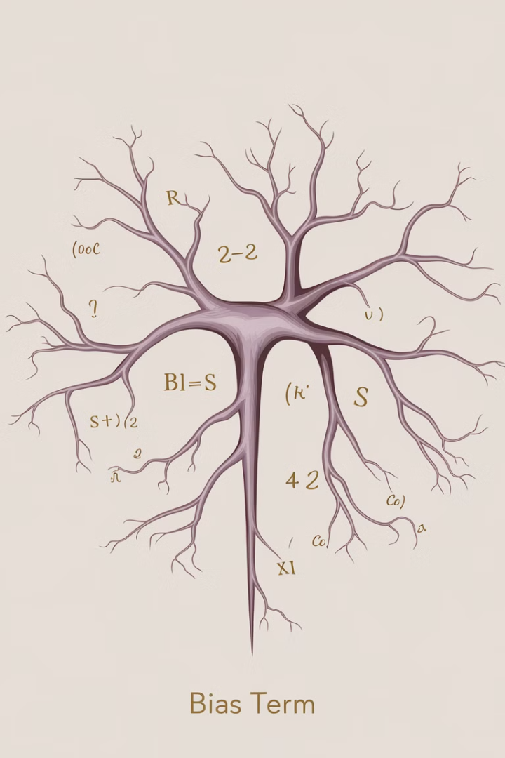
Bias Terms
In addition to the input and hidden neurons, each layer (except the input layer) usually includes a bias neuron that provides a constant input to the neurons in the next layer. Bias neurons have their own weight associated with each connection, which is also learned during training.
Purpose
Fine-tune and shift activation function threshold.
Location
Associated with neurons in hidden and output layers.
Learning
Adjusted during training along with weights.

Slide 5
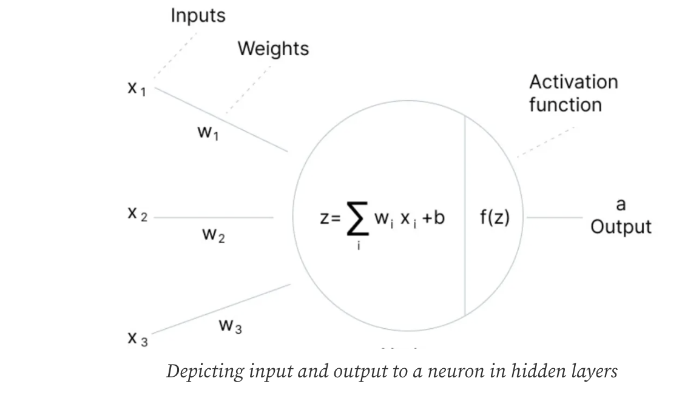
Hidden Layer Computations
1
Weighted Sum
Calculate sum of weighted inputs from previous layer.
2
Bias Addition
Add bias term to weighted sum.
3
Activation Function
Apply non-linear function to produce neuron output.

Slide 6
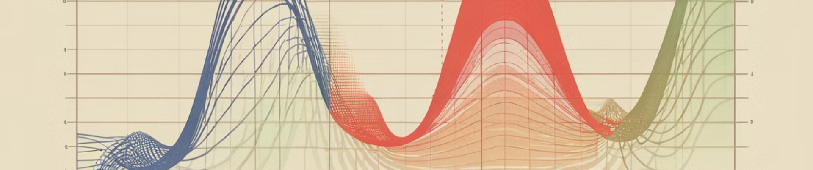
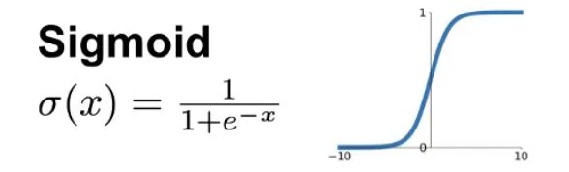
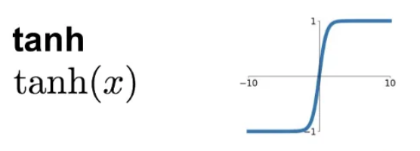



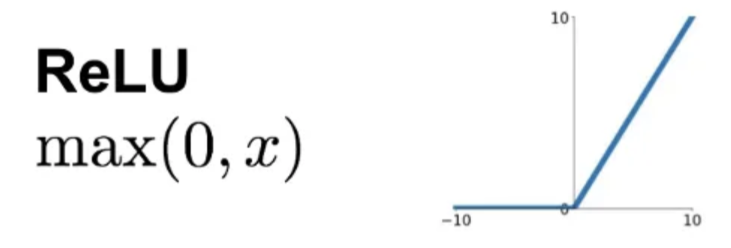
Activation Functions
In addition to the input and hidden neurons, each layer (except the input layer) usually includes a bias neuron that provides a constant input to the neurons in the next layer. Bias neurons have their own weight associated with each connection, which is also learned during training.
Sigmoid
Tanh
ReLU
S-shaped curve, outputs between 0 and 1.
Similar to sigmoid, outputs between -1 and 1.
Returns input for positive values, 0 for negative.

Slide 7



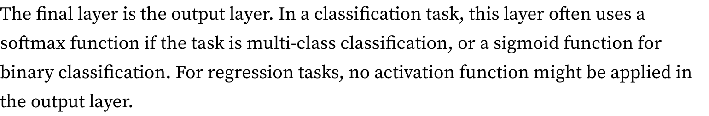
Forward Propagation
In addition to the input and hidden neurons, each layer (except the input layer) usually includes a bias neuron that provides a constant input to the neurons in the next layer. Bias neurons have their own weight associated with each connection, which is also learned during training.
Input Layer
Receive and process input data.
Hidden Layers
Apply weights, biases, and activation functions.
Output Layer
Generate final predictions or classifications.

Slide 8
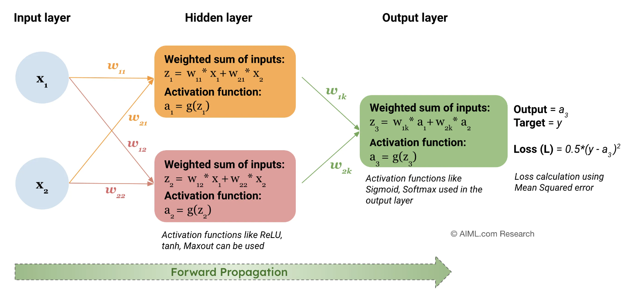

Slide 9
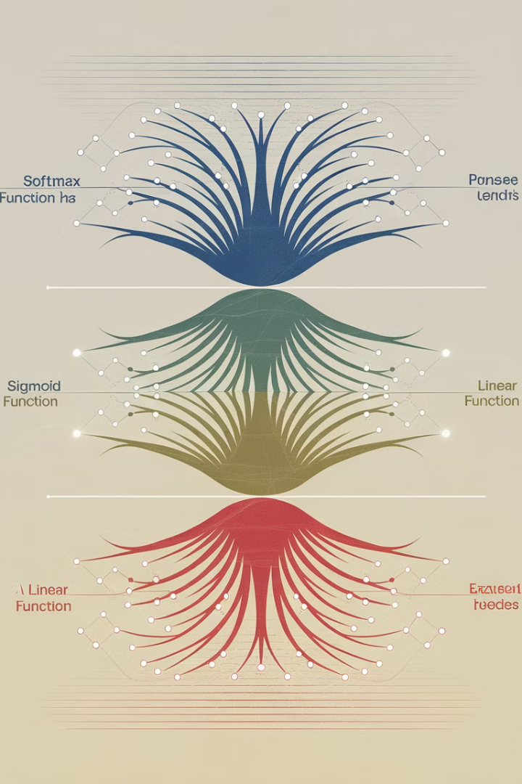
Output Layer Functions
Task
Function
Purpose
Multi-class Classification
Softmax
Probability distribution across classes
Binary Classification
Sigmoid
Probability between 0 and 1
Regression
None
Direct numerical output

Slide 10
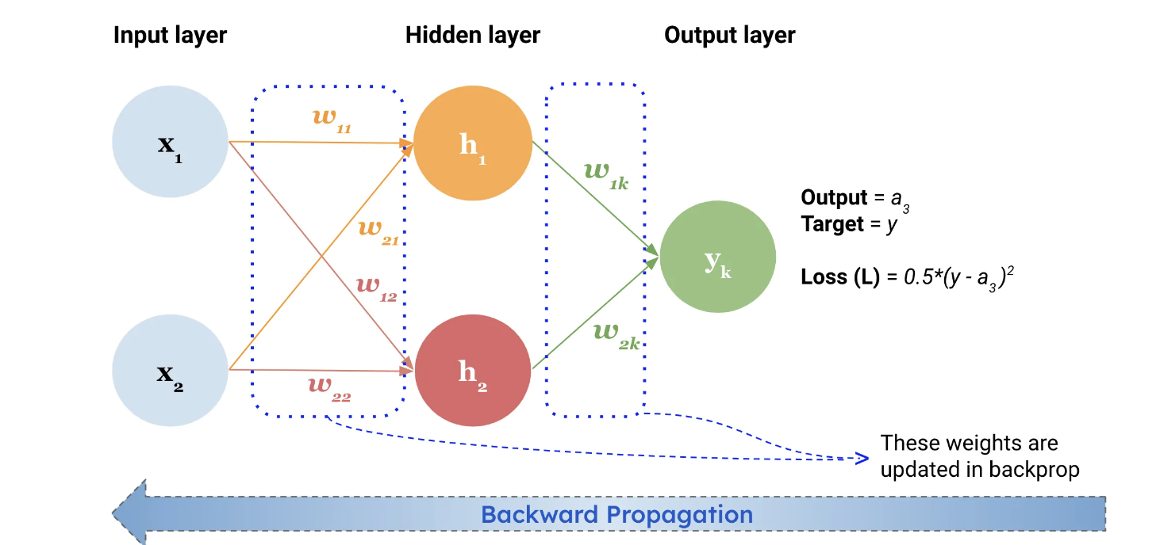
Backpropagation
In addition to the input and hidden neurons, each layer (except the input layer) usually includes a bias neuron that provides a constant input to the neurons in the next layer. Bias neurons have their own weight associated with each connection, which is also learned during training.
Error Calculation
1
Compare output to true values.
2
Error Propagation
Propagate error backwards through network.
Weight Adjustment
3
Update weights and biases to minimize error.

Slide 11
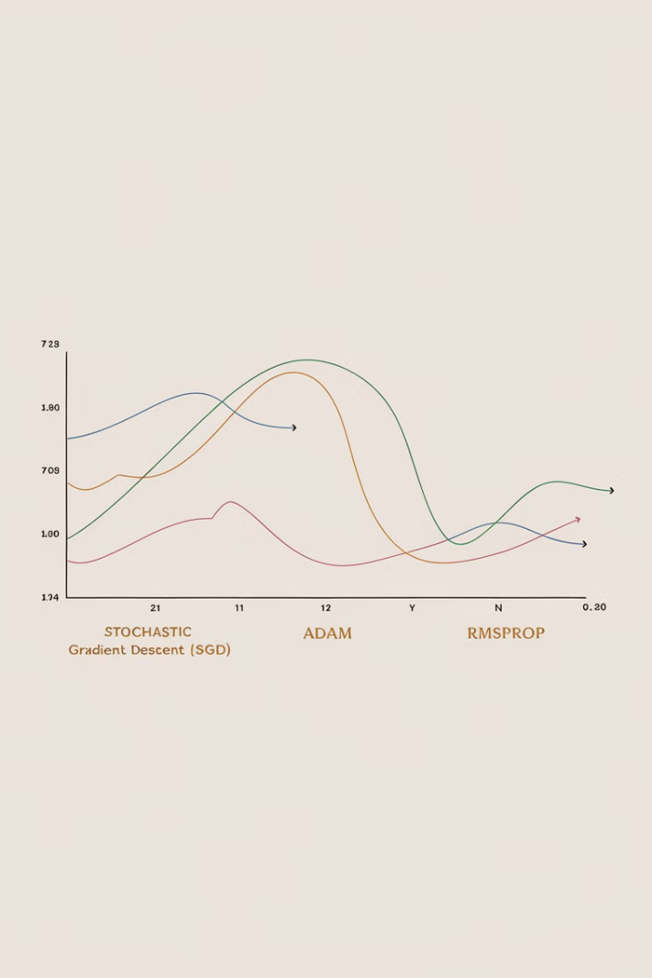
Optimization Algorithms
1
Stochastic Gradient Descent (SGD)
Updates parameters using small batches of data.
2
Adam
Adaptive learning rates for each parameter.
3
RMSprop
Adapts learning rates using moving average of squared gradients.

Slide 12





Training Process
Forward Pass
Compute network output for input data.
Error Calculation
Determine difference between prediction and true value.
Backpropagation
Update weights and biases to reduce error.
Iteration
Repeat process for many epochs.

Slide 13

Universal Function Approximation
Capability
Requirements
Significance
Can approximate any continuous function.
Sufficient hidden neurons and appropriate training.
Makes MLPs powerful for various problem types.

Slide 14





MLP Applications
Classification
Regression
NLP
Computer Vision
Sentiment analysis, fraud detection.
Score estimation, numerical predictions.
Machine translation, text analysis.
Object identification, image segmentation.

Slide 15

Advantages of MLPs
1
Flexibility
Can model complex non-linear relationships.
2
Adaptability
Applicable to various types of data and problems.
3
Performance
Can achieve high accuracy with proper tuning.

Slide 16



Further Learning
Coding Train Videos
Online Courses
Textbooks
Daniel Shiman's tutorials on MLPs.
In-depth MLP and neural network courses.
Comprehensive resources for deep learning theory.

